Slide 1
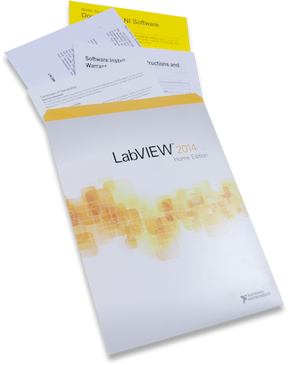
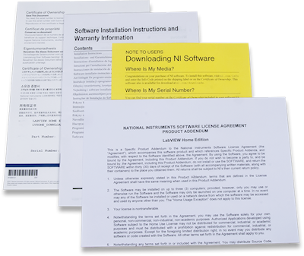
LabVIEW Home Bundle
Unique graphical programming environment for accelerated development
Why LabVIEW Home Bundle
NI LabVIEW is a graphical programming platform used by millions of engineers and scientists for problem solving, data acquisition and analysis, instrument control, automated testing and validation, prototyping, and more. Now, there's LabVIEW Home, which has been targeted at makers, allowing anyone to program visually, using icons and wires to connect hardware and other applications in a single environment.
What is LabVIEW
General Information
Part Number | 6002-549-000
List Price | $49
Academic Price | NA
Distributor Discount | 30%
Unique graphical programming environment for accelerated development
Extensive support for a wide range of measurement hardware, I/O, and buses
Drag-and-drop interaction for quickly building graphical user interfaces
Extensive signal processing, analysis, and math functionality
Includes added functionality for text-based math and control logic

Slide 2
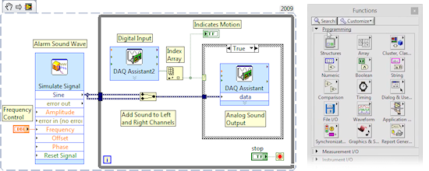
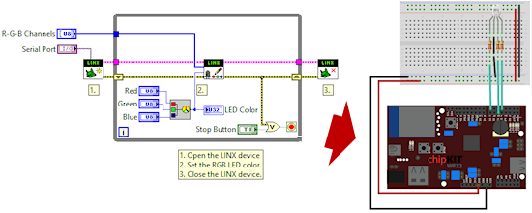
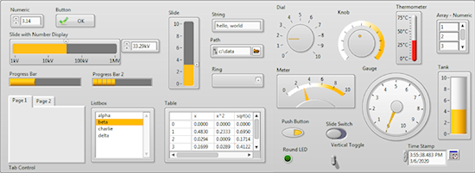
LabVIEW Home Bundle
Unique graphical programming environment for accelerated development
What can you do in LabVIEW?
Program the way you think: Visually.
You'll create programs called virtual instruments (VIs) by connecting terminals, functions, constants, and structures with wires on a block diagram.
Interface with your hardware of choice.
Use LabVIEW to connect your programs to the outside world. Connect to a microcontroller, take readings from a sensor, plot those readings on a graph, and export the results to a spreadsheet.
Create dynamic graphical user interfaces
In LabVIEW, creating a user interface is a drag-and-drop operation. Choose from hundreds of controls, graphs, and 3D visualization tools to design the front end of your application.

Slide 3
LabVIEW Home Bundle
Unique graphical programming environment for accelerated development
How to start?
Resources
Download & install the free, 45-day evaluation. You can get it via LabVIEW MakerHub (https://www.labviewmakerhub.com/doku.php?id=libraries:labview:start)
Purchase LabVIEW Home Bundle here. You'll receive a packet of info including a key you can use to unlock your trial version. Drag-and-drop interaction for quickly building graphical user interfaces
Learn how to use LabVIEW through tutorials
Resources
High-resolution picture | https://www.flickr.com/photos/127815101@N07/16983409908/in/album-72157650774599421/ https://www.flickr.com/photos/127815101@N07/17170557031/in/album-72157650774599421/ https://www.flickr.com/photos/127815101@N07/16983409758/in/album-72157650774599421/
LabVIEW Tutorials | http://www.learnni.com/getting-started https://www.labviewmakerhub.com/doku.php?id=learn:tutorials:labview:basics
Community Site | https://www.labviewmakerhub.com/
Note: This software is licensed for personal, non-commercial, non-industrial, non-academic purposes. Applications may be distributed only for non-commercial, non-industrial, non-academic purposes. This program does not include a Standard Service Program contract from NI and is therefore not eligible for direct phone or email support from NI engineers. However, support can be found on the LabVIEW MakerHub forums. (http://www.digilentinc.com/Products/labviewmakerhub.com/forums ) Students: You may be eligible for LabVIEW Student Edition, which includes the LEGO MINDSTORMS system and a free 6-month license key.

